Slide 1

MAST EVENTS
DAMG6210: EVENT MANAGEMENT SYSTEM FOR UNIVERSITY
TEAM: MAST
MAMATHASHREE (002746925)) ANUSREE (002709300)
SAGAR (002793706)
TEJA (002793709)

Slide 2
OBJECTIVE
Database design is proposed for addressing an event management application, where users can create, access and register for any event that is occurring at the university.
Student registrations in Upcoming events secure data management of Organizers and Students details in admin Panel.
Admin Login to Manage all Details such as Organizers with admin permissions can be able to create an event and store the details such as event name, venue, date and time, price of the ticket etc .
User can register only for one event at a time.

Slide 3
Problem Statement
University has multiple clubs, and they host many events throughout the academic year
Students don't understand the actual requirements of the event.
Event organizers find it hard to keep track of list of attendees and payment status.

Slide 4
Proposed solution
Database model is developed to address above problems where the stakeholders (students and event organizers) can sign up for the application to access details about all the events that are taking place in the university.
Using our database design, users who are organizers can create an event, retrieve the list of events, update the details for the existing event, delete the events.
Admins can add the organizers and users both to participate in the events and create the events.
Users (students) can register using their Northeastern email id, create their profile and access the list of events and details about them.
Registration and payment status are stored and maintained on each transaction.

Slide 5
Contd…
Provide a Secure admin panel to manage and update the important Events and News.
Remote access to the students and other users.
Ease for organizers , as they will add the events by finding space of desired venue and time schedule.
Ease for Students to view all terms and conditions of events, student will also apply in any Upcoming event.
Better to manage historical data in database by admin.

Slide 6
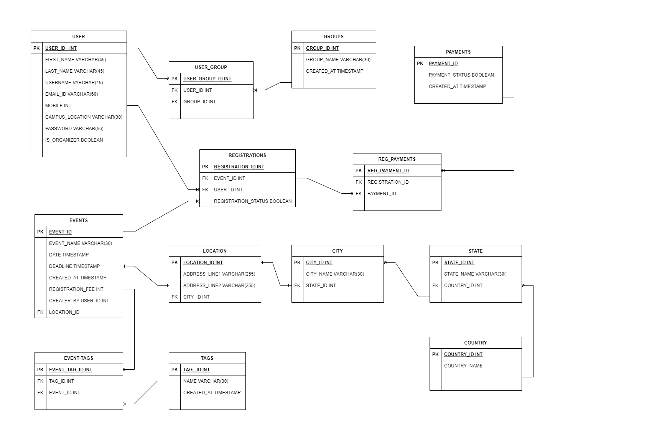
ER DIAGRAM

Slide 7
User Entity
ATTRIBUTES | DATA TYPE AND SIZE | COMMENTS
USER_ID | INTEGER | PRIMARY KEY, AUTO GENERATED
USERNAME | VARCHAR (16) | UNIQUE KEY, NOT NULL
EMAIL | VARCHAR (60) | UNIQUE KEY, NOT NULL
PASSWORD | VARCHAR (15) | NOT NULL
CAMPUS_LOCATION | VARCHAR (45) | NOT NULL
FIRST_NAME | VARCHAR (45) | NOT NULL
LAST_NAME | VARCHAR (45) | NOT NULL
PHONE_NUMBER | INTEGER | NOT NULL

Slide 8
Event Entity
ATTRIBUTES | DATA TYPE AND SIZE | COMMENTS
EVENT_ID | INTEGER | PRIMARY KEY, AUTO GENERATED
EVENT_NAME | VARCHAR (16) | UNIQUE KEY, NOT NULL
DATE | TIMESTAMP | CURRENT_TIMESTAMP
DEADLINE | TIMESTAMP | CURRENT_TIMESTAMP
CREATEDAT | TIMESTAMP | CURRENT_TIMESTAMP
REG_FEE | INT | NOT NULL
EVENT_TYPE | VARCHAR (45) | NOT NULL
ORGANIZER_ID | INTEGER | FORIENT KEY,NOT NULL

Slide 9
Thank you

